Slide 1
Lakshana JK 711721244027
Final Project

Slide 2
PROJECT TITLE
Deep Learning Approach for Breast Cancer Classification

Slide 3


AGENDA
Introduction
Problem Statement
Project Overview
End Users
Solution and Value Proposition
Key Features
Modelling Approach
Conclusion
3/21/2024 Annual Review

Slide 4

PROBLEM
STATEMENT
Breast cancer remains a significant health concern globally, with millions of new cases diagnosed each year.
Despite advancements in medical technology, accurate and timely diagnosis of breast cancer continues to be a challenge.
Manual interpretation of mammography and histopathology images is subjective and prone to inter-observer variability.
There is a pressing need for automated systems that can enhance the accuracy and efficiency of breast cancer diagnosis.

Slide 5

PROJECT OVERVIEW
Our project focuses on developing a deep learning-based system for automated breast cancer classification.
By leveraging convolutional neural networks (CNNs), we aim to analyze digital mammography and histopathology images to classify tumors as benign or malignant.
The project encompasses data collection, preprocessing, model development, training, and validation phases.
Our ultimate goal is to create a tool that can assist healthcare professionals in making more accurate and timely diagnoses, leading to improved patient outcomes..

Slide 6

WHO ARE THE END USERS?
The primary end users of our solution are healthcare professionals involved in breast cancer diagnosis, including radiologists and pathologists.
By providing them with a reliable and efficient tool for image analysis, we aim to enhance their diagnostic capabilities and streamline the decision-making process.
Patients and their families will also benefit from faster diagnosis and treatment initiation, potentially improving survival rates and quality of life.
Additionally, healthcare institutions and policymakers may benefit from the system's ability to optimize resource allocation and reduce healthcare costs associated with manual image interpretation.

Slide 7
YOUR SOLUTION AND ITS VALUE PROPOSITION
Our deep learning-based solution offers several key benefits:
Improved diagnostic accuracy: By analyzing digital images with advanced algorithms, our system can detect subtle patterns indicative of breast cancer with high precision.
Enhanced efficiency: Automation of image analysis reduces the time required for diagnosis, enabling prompt initiation of treatment.
Cost savings: By minimizing the need for manual review and interpretation of images, our solution can help healthcare institutions optimize resource utilization and reduce operating costs.
Empowering healthcare professionals: Our user-friendly interface and intuitive design make it easy for radiologists and pathologists to integrate our tool into their existing workflow, without the need for extensive training in deep learning techniques.

Slide 8

THE WOW IN YOUR SOLUTION
What sets our solution apart is its ability to surpass human performance in certain aspects of breast cancer diagnosis.
Through extensive training on large datasets, our deep learning model has achieved remarkable accuracy and reliability in classifying tumors.
The system's adaptive learning capabilities enable it to continuously improve over time, ensuring ongoing reliability and effectiveness.
Moreover, our solution is scalable and can be customized to suit the specific needs and preferences of different healthcare settings, from small clinics to large hospitals.
3/21/2024 Annual Review

Slide 9
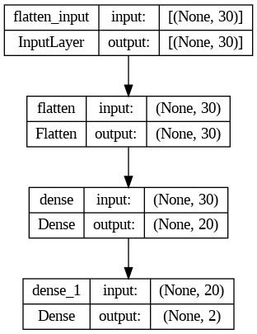
MODELLING
Input Layer:
Receives data with 30 features.
Flatten Layer:
Converts input data into a 1D array (output shape: (None, 30)).
Dense Layers:
Two dense layers:
First layer reduces dimensionality to 20.
Second layer produces final output (shape: (None, 2)).

Slide 10
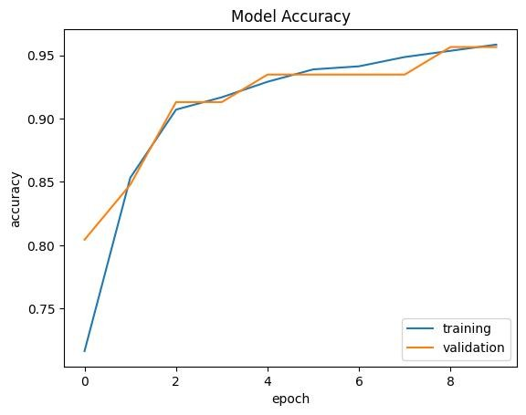
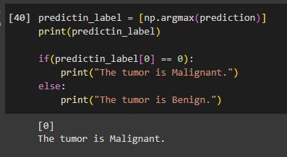
RESULTS

